Slide 1

predicting
PHISHING attacks in
EMAILs

Slide 2
INTRODUCTION :
  Phishing email detection is a critical cybersecurity measure designed to protect individuals and organizations from fraudulent emails that attempt to steal sensitive information or install malware. These emails often mimic legitimate sources, making them challenging to identify manually. By leveraging machine learning and natural language processing techniques, we can develop automated systems to accurately distinguish between phishing and legitimate emails. This project aims to create a robust detection model, enhancing email security and safeguarding users from potential cyber threats.

Slide 3
PROJECT OVERVIEW:
The primary objective of our phishing detection project is to create a system capable of analyzing incoming emails and accurately determining whether they are phishing attempts. We leverage a Random Forest model, a powerful and versatile machine learning algorithm known for its high accuracy and ability to handle diverse datasets.
By integrating this model with the Gmail API, we ensure that our system can access and analyze emails directly from a user's Gmail account, providing real-time feedback on the nature of the emails received. This integration enhances email security and helps users avoid potential phishing threats.

Slide 4
System Architecture:
Our system architecture is designed to seamlessly integrate with the Gmail API and process emails efficiently. After a user signs into their Gmail account, the system fetches emails and passes them through the Random Forest model for analysis. The model examines various features of the emails, such as content, sender information, and embedded links, to determine the likelihood of a phishing attempt. The real-time analysis ensures that users receive immediate feedback on the safety of their emails, enabling them to take prompt action against any detected threats. The architecture includes secure authentication mechanisms to protect user data and maintain privacy.

Slide 5
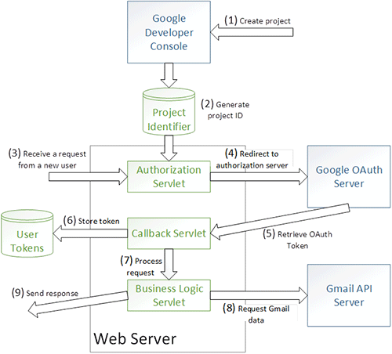
Implementation Details:
Integrating with the Gmail API involves several steps, including setting up a Google Cloud project, enabling the Gmail API, and configuring OAuth 2.0 credentials for authentication. Once these steps are completed, the system can securely access and read emails from the user's Gmail account. The Random Forest model is trained on a dataset of labeled emails, with features such as email content, sender information, and links used to classify emails as phishing or legitimate. We faced technical challenges, such as managing OAuth authentication tokens and ensuring the model's generalization to unseen data, but overcame these with robust solutions and thorough testing.

Slide 6
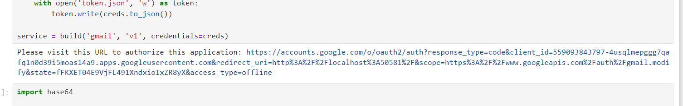
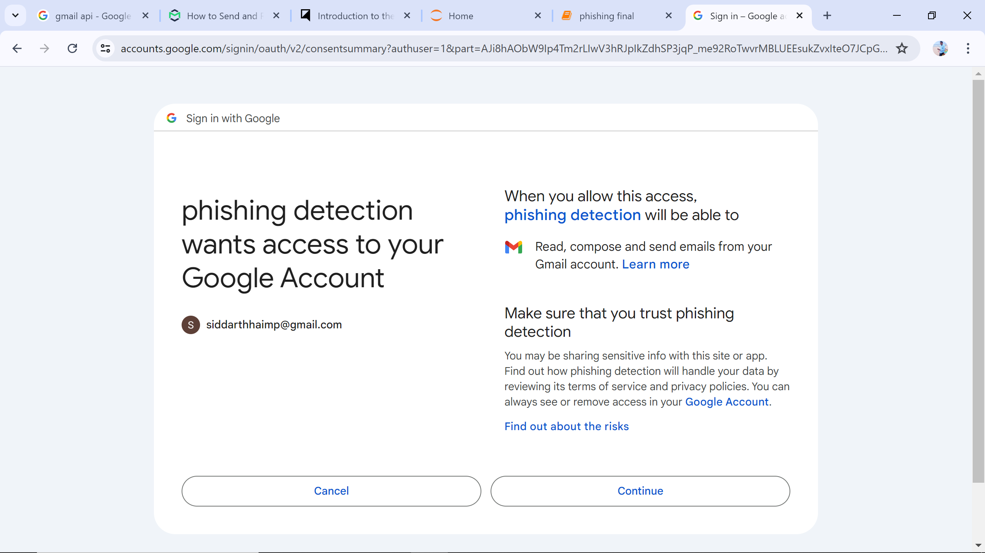
Implementation Details:

Slide 7
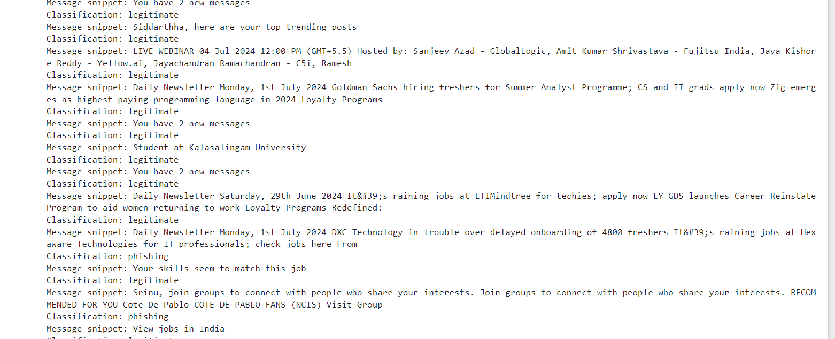
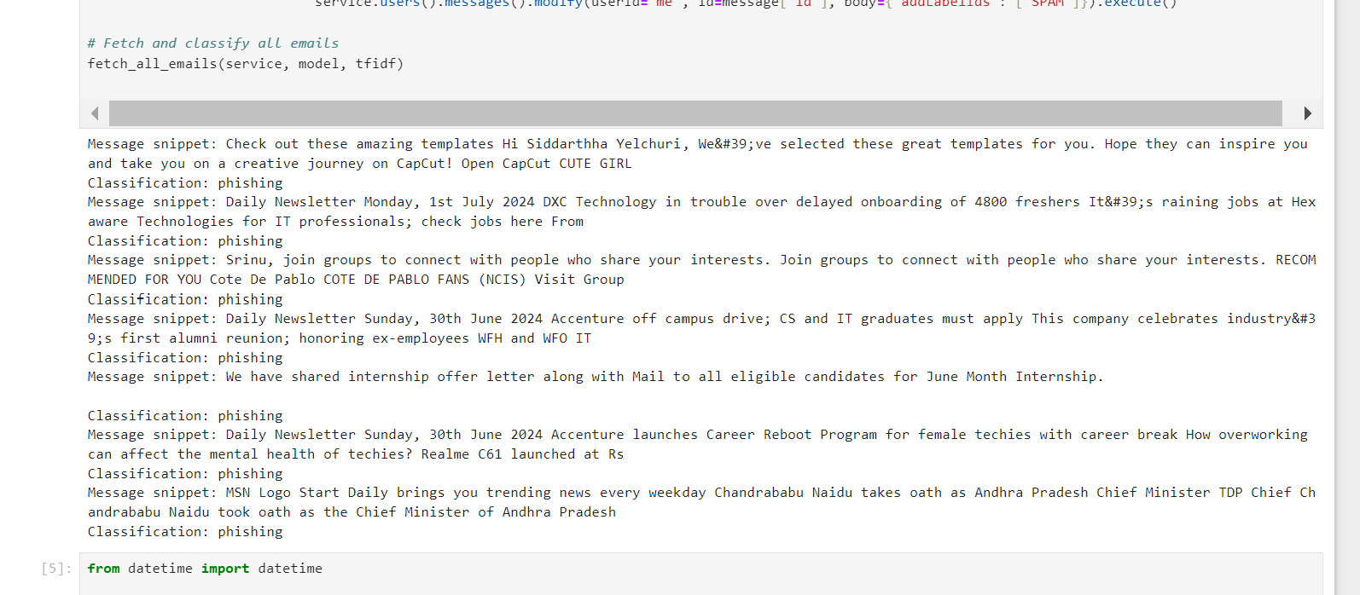
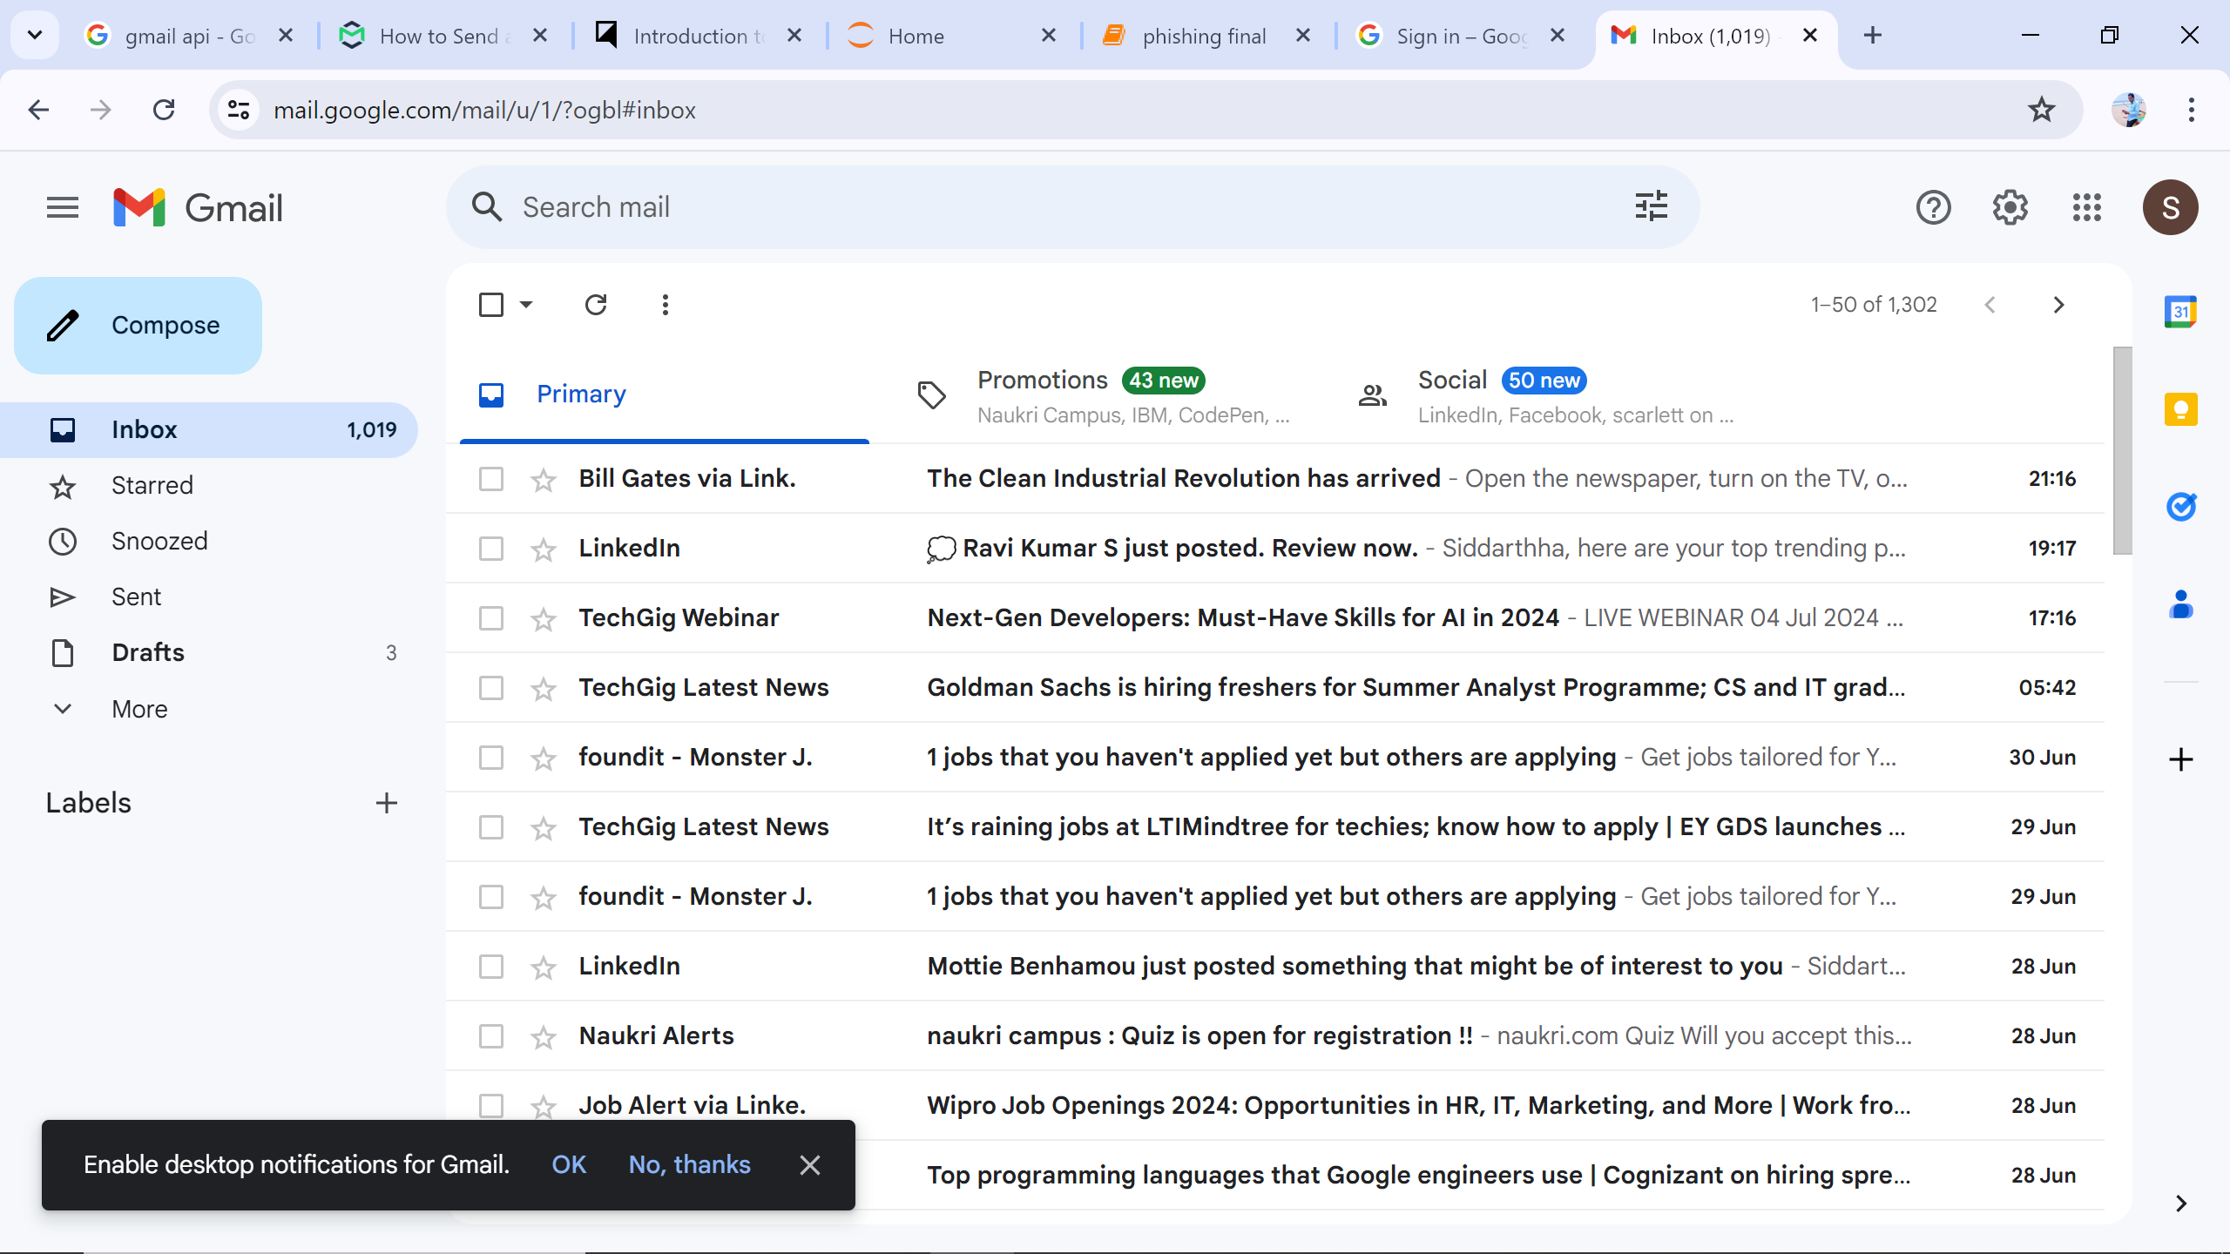
Output:

Slide 8
CONCLUSION:
In conclusion, our project successfully integrates a phishing detection system with the Gmail API, enabling real-time analysis of incoming emails. The Random Forest model's high accuracy ensures effective identification of phishing attempts, enhancing email security for users. Moving forward, we plan to improve the system by incorporating more training data and additional features to further boost detection rates. We also aim to expand the system's compatibility to include other email providers, broadening its applicability and impact. Our work demonstrates the potential of machine learning in cybersecurity and its practical implementation in protecting users from phishing threats.

